Slide 1
Image Processing
Lecture 1
Introducing Image Processing

Slide 2
What Is An image ?
An image is a two-dimensional function, f(x,y), where x and y are spatial (plane) coordinates, and the amplitude of f(x,y) at any pair of coordinates (x, y) is called the intensity or gray level of the image at the point (x,y).
Note: When x, y, and the amplitude values of f are all finite, discrete quantities, we call the image a digital image.

Slide 3
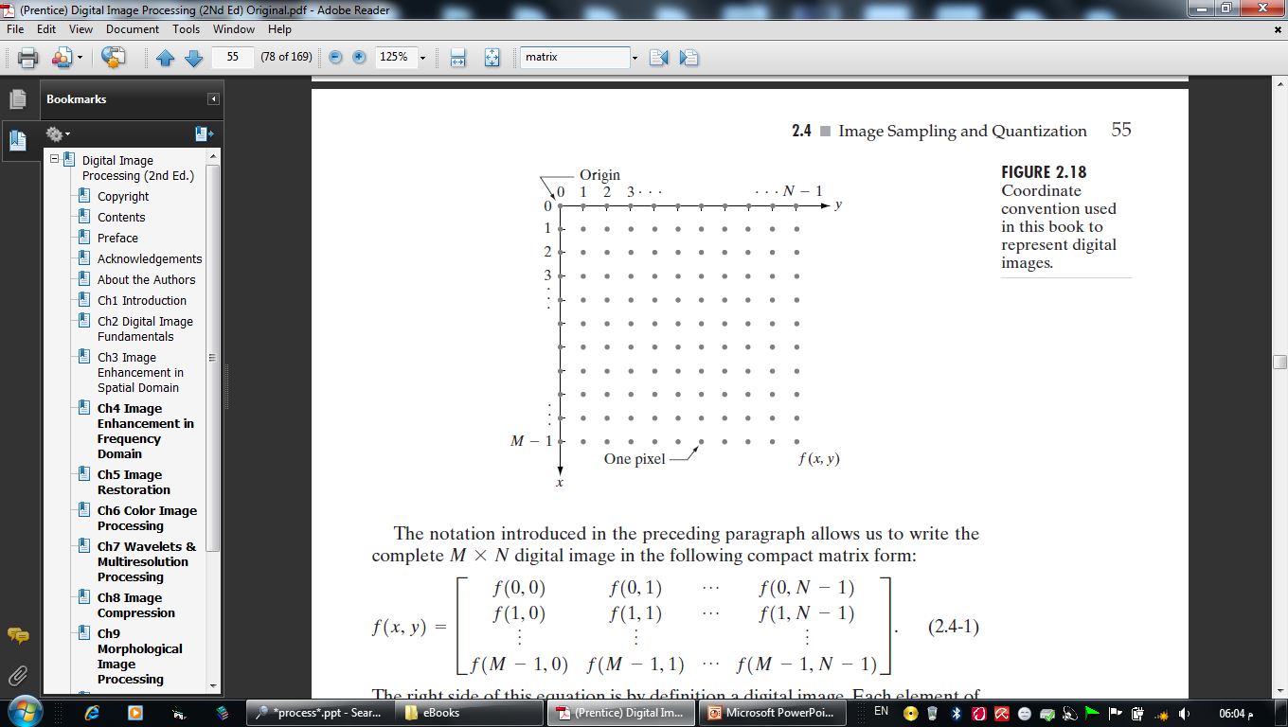
What Is A digital Image ?
A digital image is a two-dimensional matrix, f(M,N), where the value at the location (x,y) is called the intensity or gray level of the image at the point (x,y).
So, the digital image is composed of a finite number of elements, each of which has a particular location and value.
The digital image elements are referred to pels, and pixel

Slide 4
What Is Digital Image Processing?
Digital image processing field, is a preprocessing step for other computerized processing fields such as computer vision and pattern recognition.
In computer vision, the goal is to use computers to emulate human vision, including learning (understanding) and being able to make inferences and take actions based on visual inputs.

Slide 5
Cont.,
There are no clear-cut boundaries in the continuum from image processing at one end to computer vision at the other.
So, we can consider three types of computerized processes in this continuum: low-, mid-, and high-level processes.
Low-Level
Mid-Level
High-Level

Slide 6
Cont.,
Low-level processes involve primitive operations such as noise reducing, contrast enhancement, and image sharpening.
Mid-level processing on images involves tasks such as segmentation, description of those objects to reduce them to a form suitable for computer processing.
Higher-level processing involves “making sense” of an ensemble of recognized objects, as in image analysis, and, at the far end of the continuum, performing the cognitive functions.

Slide 7
Cont.,
Thus, digital image processing encompasses processes whose inputs and outputs are images and, in addition, encompasses processes that extract attributes from images, up to and including the recognition of individual objects.

Slide 8
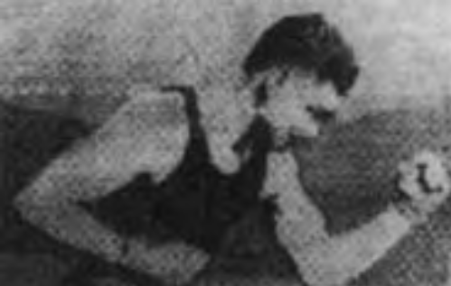
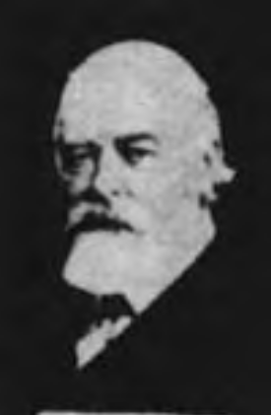
The Origins of Digital Image Processing
One of the first applications of digital images was in the newspaper industry, when pictures were first sent by submarine cable between London and New York (Bartlane cable).
- produced in 1921 (telegraph)
- five distinct levels of gray
- produced in 1922 (telegraph)
- after the signals had crossed the Atlantic twice

Slide 9
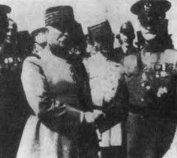
Cont.,
- produced in 1929 (telegraph)
- 15 distinct levels of gray
The history of digital image processing is intimately tied to the development of the digital computer

Slide 10
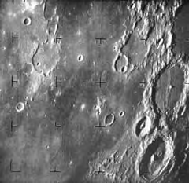
Cont.,
The first computers powerful enough to carry out meaningful image processing tasks appeared in the early 1960s.
- In 1964 when pictures of the moon transmitted by Ranger 7.
- processed by a computer to correct various types of image distortion inherent in the on-board television camera.

Slide 11
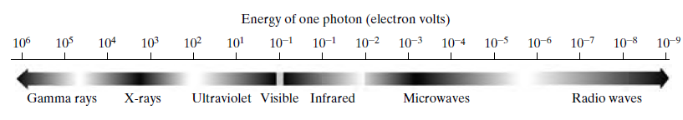
Electromagnetic spectrum (EM)
Electromagnetic waves are sinusoidal waves of varying wavelengths, or are a stream of massless particles, each traveling in a wavelike pattern and moving at the speed of light.
Each massless particle contains a certain amount (or bundle) of energy (photon)

Slide 12
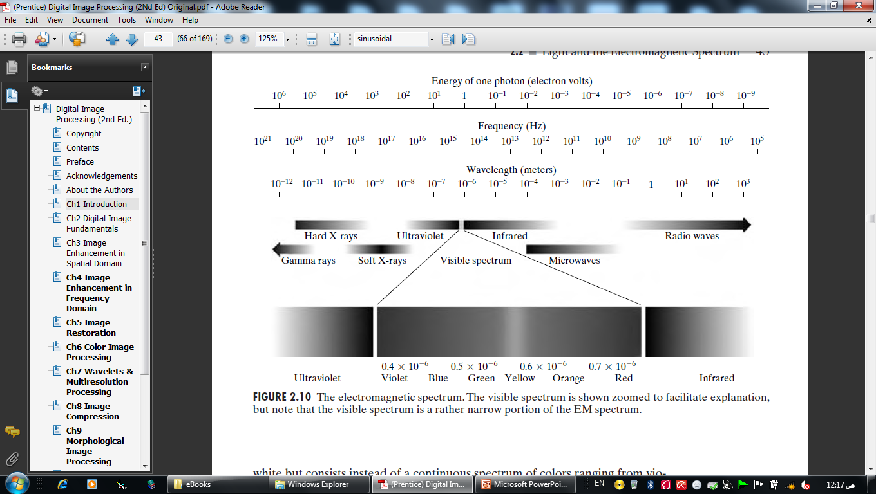
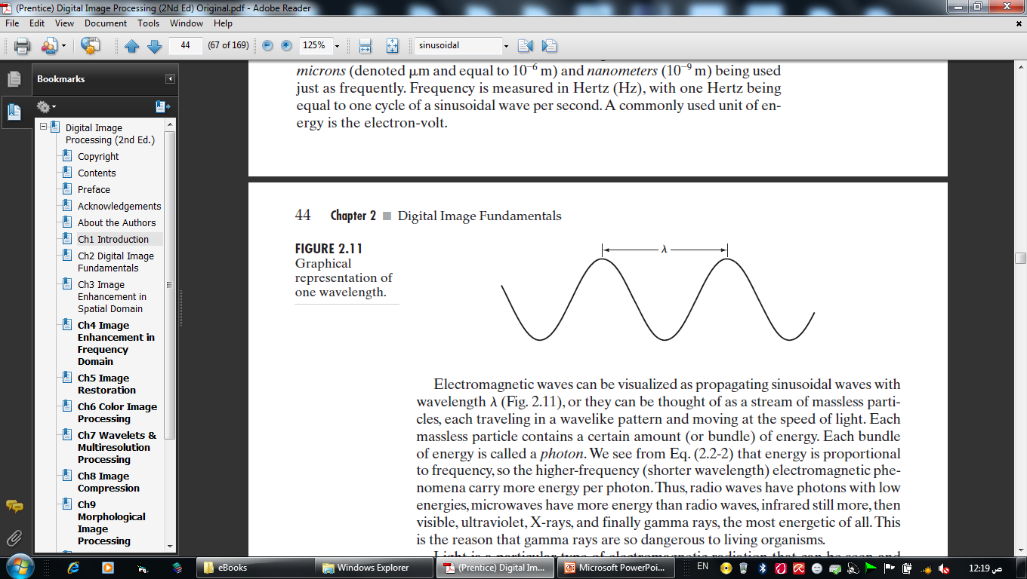
Cont.,

Slide 13
Image Types
Image types according to energy source:
1- Electromagnetic energy spectrum images
2- Acoustic & ultrasonic images
3- Electronic images
4- Computer modeling images

Slide 14
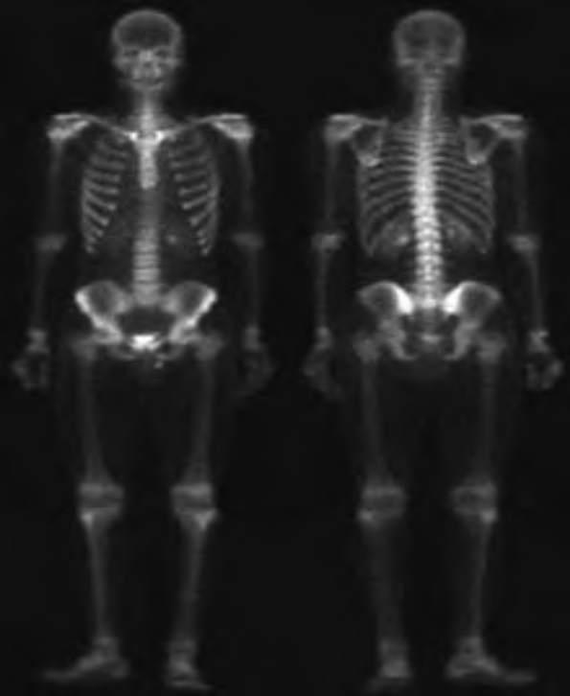
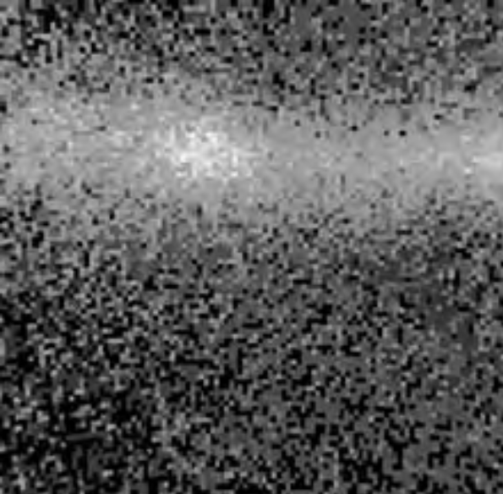
Examples of Fields that Use Digital Image Processing
1- Gamma-Ray Imaging
Astronomical observations
(Cygnus Loop))
Medicine System

Slide 15
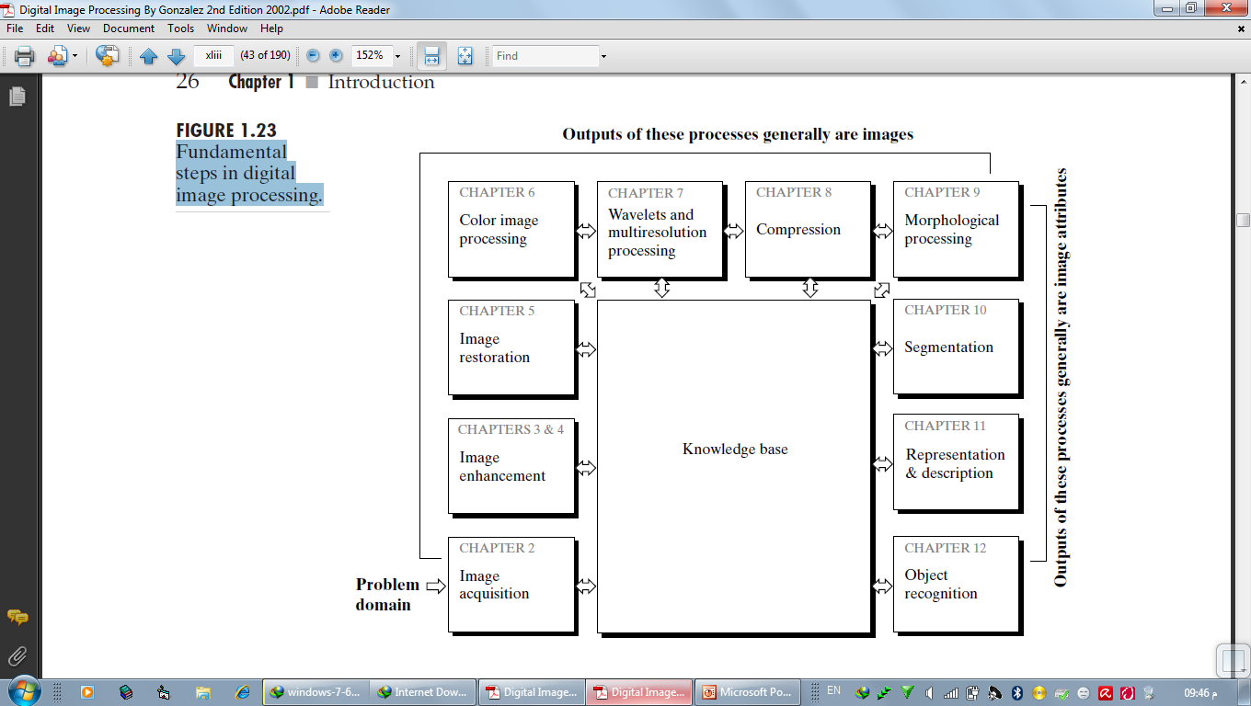
Fundamental steps in digital image processing.

